Slide 1

Dimensionality Reduction: SVD & CUR
Modified from CS246: Mining Massive Datasets
Jure Leskovec, Stanford University
http://cs246.stanford.edu
Notes:
Announcements:
-- Enjoyed the lecture, Jeff apologizes 10 min over
-- Print the code & 10 pairs, in the ZIP include everything – the big file also
-- HW1 due Fri, max 3 late days, hand in Mon 9:30am
-- HW2 will be out Fri
-- MapReduce and Freq Itermse Gradiance quizzes due today
-- LSH quiz out! Due in 1 week!

Slide 2

Reducing Matrix Dimension
Often, our data can be represented by an $m$-by-$n$ matrix
And this matrix can be closely approximated by the product of three matrices that share a small common dimension $r$
n
r
r
n
A
U
×
Σ
×
V^{T}
r
m
~~

Slide 3
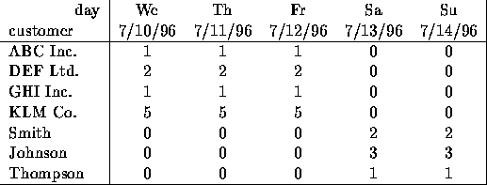
Dimensionality Reduction
Compress / reduce dimensionality:
10⁶ rows; 10³ columns; no updates
Random access to any cell(s); small error: OK
New representation
[1 0]
[2 0]
[1 0]
[5 0]
[0 2]
[0 3]
[0 1]
Note: The above matrix is really “2-dimensional.” All rows can be reconstructed by scaling [1 1 1 0 0] or [0 0 0 1 1]

Slide 4
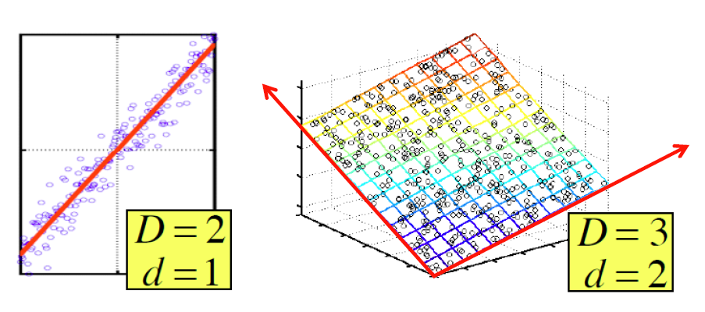
Dimensionality Reduction
There are hidden, or latent factors, latent dimensions that – to a close approximation – explain why the values are as they appear in the data matrix

Slide 5
Dimensionality Reduction
The axes of these dimensions can be chosen by:
The first dimension is the direction in which the points exhibit the greatest variance
The second dimension is the direction, orthogonal to the first, in which points show the greatest variance
And so on…, until you have enough dimensions that variance is really low

Slide 6

Rank is “Dimensionality”
Q: What is rank of a matrix A?
A: Number of linearly independent rows of A
Cloud of points 3D space:
Think of point positions as a matrix:
We can rewrite coordinates more efficiently!
Old basis vectors: [1 0 0] [0 1 0] [0 0 1]
New basis vectors: [1 2 1] [-2 -3 1]
Then A has new coordinates: [1 0], B: [0 1], C: [1 -1]
Notice: We reduced the number of coordinates!
A
A
B
C
1 row per point:

Slide 7
Dimensionality Reduction
Goal of dimensionality reduction is to discover the axis of data!
Rather than representing every point with 2 coordinates we represent each point with
1 coordinate (corresponding to the position of the point on the red line).
By doing this we incur a bit of error as the points do not exactly lie on the line

Slide 8
SVD: Singular Value Decomposition

Slide 9
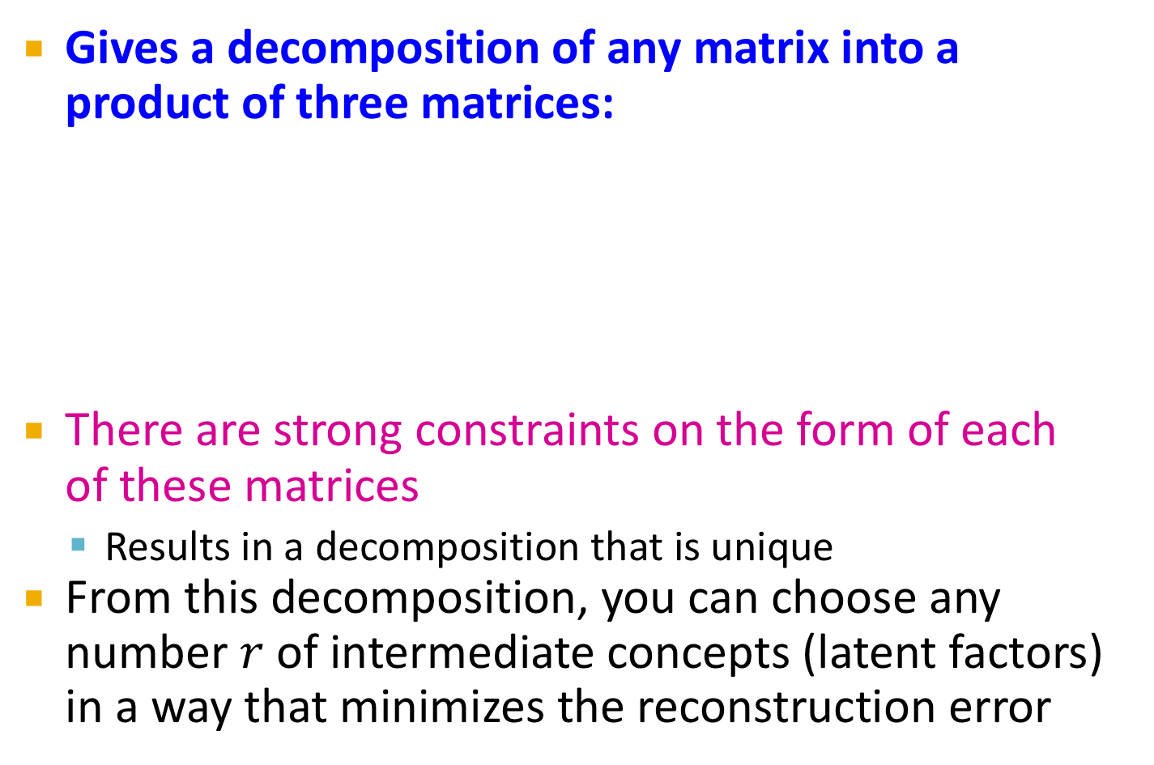
Reducing Matrix Dimension
Gives a decomposition of any matrix into a product of three matrices:
There are strong constraints on the form of each of these matrices
Results in a decomposition that is unique
From this decomposition, you can choose any number $r$ of intermediate concepts (latent factors) in a way that minimizes the reconstruction error
n
r
r
n
A
U
×
Σ
×
V^{T}
r
m
~

Slide 10
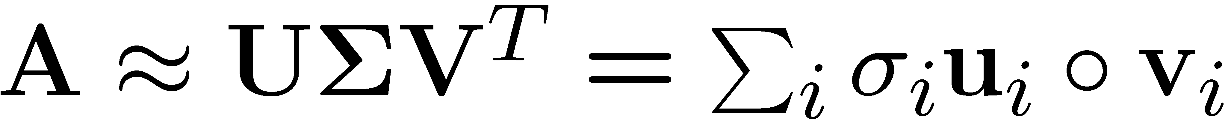
SVD - Definition
T
n
r
r
n
r
A
≈
Σ
V^{T}
m
m
U
A: Input data matrix
m x n matrix (e.g., m documents, n terms)
U: Left singular vectors
m x r matrix (m documents, r concepts)
Σ: Singular values
r x r diagonal matrix (strength of each ‘concept’) (r : rank of the matrix A)
V: Right singular vectors
n x r matrix (n terms, r concepts)

Slide 11
SVD
T
n
σ₁u₁v₁
σ₂u₂v₂
A
≈
m
+
σ_{i} … scalar
u_{i} … vector
v_{i} … vector
If we set σ₂ = 0, then the green
columns may as well not exist.

Slide 12
SVD - Properties
It is always possible to decompose a real matrix A into A = U Σ V^{T} , where
U, Σ, V: unique
U, V: column orthonormal
U^{T} U = I; V^{T} V = I (I: identity matrix)
(Columns are orthogonal unit vectors)
Σ: diagonal
Entries (singular values) are positive, and sorted in decreasing order (σ₁ ≥ σ₂ ≥ ... ≥ 0)
Nice proof of uniqueness: http://www.mpi-inf.mpg.de/~bast/ir-seminar-ws04/lecture2.pdf

Slide 13
SVD – Example: Users-to-Movies
Consider a matrix. What does SVD do?
Matrix
Alien
Serenity
Casablanca
Amelie
n
1 1 1 0 0
3 3 3 0 0
4 4 4 0 0
5 5 5 0 0
0 2 0 4 4
0 0 0 5 5
0 1 0 2 2
SciFi
Σ
V^{T}
=
m
Romance
U
“Concepts” AKA Latent dimensions AKA Latent factors

Slide 14
SVD – Example: Users-to-Movies
A = U Σ V^{T} - example: Users to Movies
Matrix
Alien
Serenity
Casablanca
Amelie
1 1 1 0 0
3 3 3 0 0
4 4 4 0 0
5 5 5 0 0
0 2 0 4 4
0 0 0 5 5
0 1 0 2 2
0.13 0.02 -0.01
0.41 0.07 -0.03
0.55 0.09 -0.04
0.68 0.11 -0.05
0.15 -0.59 0.65
0.07 -0.73 -0.67
0.07 -0.29 0.32
SciFi
12.4 0 0
0 9.5 0
0 0 1.3
=
x
x
Romance
0.56 0.59 0.56 0.09 0.09
0.12 -0.02 0.12 -0.69 -0.69
0.40 -0.80 0.40 0.09 0.09

Slide 15
SVD – Example: Users-to-Movies
A = U Σ V^{T} - example: Users to Movies
Matrix
Alien
Serenity
Casablanca
Amelie
SciFi-concept
Romance-concept
1 1 1 0 0
3 3 3 0 0
4 4 4 0 0
5 5 5 0 0
0 2 0 4 4
0 0 0 5 5
0 1 0 2 2
0.13 0.02 -0.01
0.41 0.07 -0.03
0.55 0.09 -0.04
0.68 0.11 -0.05
0.15 -0.59 0.65
0.07 -0.73 -0.67
0.07 -0.29 0.32
SciFi
12.4 0 0
0 9.5 0
0 0 1.3
=
x
x
Romance
0.56 0.59 0.56 0.09 0.09
0.12 -0.02 0.12 -0.69 -0.69
0.40 -0.80 0.40 0.09 0.09

Slide 16
SVD – Example: Users-to-Movies
U is “user-to-concept”
factor matrix
A = U Σ V^{T} - example:
Matrix
Alien
Serenity
Casablanca
Amelie
SciFi-concept
Romance-concept
1 1 1 0 0
3 3 3 0 0
4 4 4 0 0
5 5 5 0 0
0 2 0 4 4
0 0 0 5 5
0 1 0 2 2
0.13 0.02 -0.01
0.41 0.07 -0.03
0.55 0.09 -0.04
0.68 0.11 -0.05
0.15 -0.59 0.65
0.07 -0.73 -0.67
0.07 -0.29 0.32
SciFi
12.4 0 0
0 9.5 0
0 0 1.3
=
x
x
Romance
0.56 0.59 0.56 0.09 0.09
0.12 -0.02 0.12 -0.69 -0.69
0.40 -0.80 0.40 0.09 0.09

Slide 17
SVD – Example: Users-to-Movies
A = U Σ V^{T} - example:
Matrix
Alien
Serenity
Casablanca
Amelie
SciFi-concept
“strength” of the SciFi-concept
1 1 1 0 0
3 3 3 0 0
4 4 4 0 0
5 5 5 0 0
0 2 0 4 4
0 0 0 5 5
0 1 0 2 2
0.13 0.02 -0.01
0.41 0.07 -0.03
0.55 0.09 -0.04
0.68 0.11 -0.05
0.15 -0.59 0.65
0.07 -0.73 -0.67
0.07 -0.29 0.32
SciFi
SciFi
12.4 0 0
0 9.5 0
0 0 1.3
=
x
x
Romance
0.56 0.59 0.56 0.09 0.09
0.12 -0.02 0.12 -0.69 -0.69
0.40 -0.80 0.40 0.09 0.09

Slide 18
SVD – Example: Users-to-Movies
A = U Σ V^{T} - example:
Matrix
Alien
Serenity
Casablanca
Amelie
V is “movie-to-concept”
factor matrix
SciFi-concept
1 1 1 0 0
3 3 3 0 0
4 4 4 0 0
5 5 5 0 0
0 2 0 4 4
0 0 0 5 5
0 1 0 2 2
0.13 0.02 -0.01
0.41 0.07 -0.03
0.55 0.09 -0.04
0.68 0.11 -0.05
0.15 -0.59 0.65
0.07 -0.73 -0.67
0.07 -0.29 0.32
SciFi
12.4 0 0
0 9.5 0
0 0 1.3
=
x
x
Romance
0.56 0.59 0.56 0.09 0.09
0.12 -0.02 0.12 -0.69 -0.69
0.40 -0.80 0.40 0.09 0.09
SciFi-concept

Slide 19
SVD - Interpretation #1
‘movies’, ‘users’ and ‘concepts’:
U: user-to-concept matrix
V: movie-to-concept matrix
Σ: its diagonal elements: ‘strength’ of each concept

Slide 20
Dimensionality Reduction with SVD

Slide 21
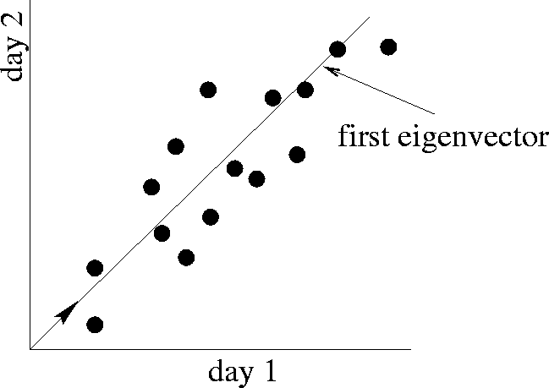
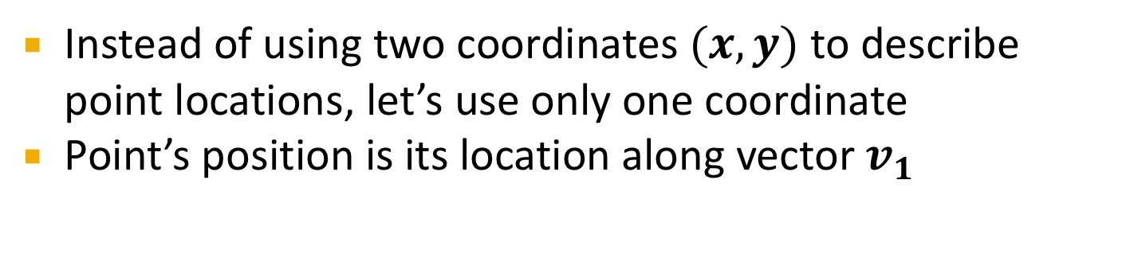
SVD – Dimensionality Reduction
Movie 2 rating
first right singular vector
v₁
Movie 1 rating
Instead of using two coordinates $(x,y)$ to describe point locations, let’s use only one coordinate
Point’s position is its location along vector $v_{1}$

Slide 22
SVD – Dimensionality Reduction
A = U Σ V^{T} - example:
V: “movie-to-concept” matrix
U: “user-to-concept” matrix
Movie 2 rating
first right singular vector
v₁
1 1 1 0 0
3 3 3 0 0
4 4 4 0 0
5 5 5 0 0
0 2 0 4 4
0 0 0 5 5
0 1 0 2 2
0.13 0.02 -0.01
0.41 0.07 -0.03
0.55 0.09 -0.04
0.68 0.11 -0.05
0.15 -0.59 0.65
0.07 -0.73 -0.67
0.07 -0.29 0.32
Movie 1 rating
12.4 0 0
0 9.5 0
0 0 1.3
=
x
x
0.56 0.59 0.56 0.09 0.09
0.12 -0.02 0.12 -0.69 -0.69
0.40 -0.80 0.40 0.09 0.09

Slide 23
SVD – Dimensionality Reduction
A = U Σ V^{T} - example:
Movie 2 rating
first right singular vector
variance (‘spread’) on the v₁ axis
v₁
1 1 1 0 0
3 3 3 0 0
4 4 4 0 0
5 5 5 0 0
0 2 0 4 4
0 0 0 5 5
0 1 0 2 2
0.13 0.02 -0.01
0.41 0.07 -0.03
0.55 0.09 -0.04
0.68 0.11 -0.05
0.15 -0.59 0.65
0.07 -0.73 -0.67
0.07 -0.29 0.32
Movie 1 rating
12.4 0 0
0 9.5 0
0 0 1.3
=
x
x
0.56 0.59 0.56 0.09 0.09
0.12 -0.02 0.12 -0.69 -0.69
0.40 -0.80 0.40 0.09 0.09

Slide 24
SVD – Dimensionality Reduction
A = U Σ V^{T} - example:
U Σ: Gives the coordinates of the points in the projection axis
Movie 2 rating
first right singular vector
v₁
1 1 1 0 0
3 3 3 0 0
4 4 4 0 0
5 5 5 0 0
0 2 0 4 4
0 0 0 5 5
0 1 0 2 2
Projection of users on the “Sci-Fi” axis (U Σ) ^{Τ}:
Movie 1 rating
1.61 0.19 -0.01
5.08 0.66 -0.03
6.82 0.85 -0.05
8.43 1.04 -0.06
1.86 -5.60 0.84
0.86 -6.93 -0.87
0.86 -2.75 0.41

Slide 25
SVD - Interpretation #2
More details
Q: How is dim. reduction done?
1 1 1 0 0
3 3 3 0 0
4 4 4 0 0
5 5 5 0 0
0 2 0 4 4
0 0 0 5 5
0 1 0 2 2
0.13 0.02 -0.01
0.41 0.07 -0.03
0.55 0.09 -0.04
0.68 0.11 -0.05
0.15 -0.59 0.65
0.07 -0.73 -0.67
0.07 -0.29 0.32
12.4 0 0
0 9.5 0
0 0 1.3
=
x
x
0.56 0.59 0.56 0.09 0.09
0.12 -0.02 0.12 -0.69 -0.69
0.40 -0.80 0.40 0.09 0.09

Slide 26
SVD - Interpretation #2
More details
Q: How exactly is dim. reduction done?
A: Set smallest singular values to zero
1 1 1 0 0
3 3 3 0 0
4 4 4 0 0
5 5 5 0 0
0 2 0 4 4
0 0 0 5 5
0 1 0 2 2
0.13 0.02 -0.01
0.41 0.07 -0.03
0.55 0.09 -0.04
0.68 0.11 -0.05
0.15 -0.59 0.65
0.07 -0.73 -0.67
0.07 -0.29 0.32
12.4 0 0
0 9.5 0
0 0 1.3
=
x
x
0.56 0.59 0.56 0.09 0.09
0.12 -0.02 0.12 -0.69 -0.69
0.40 -0.80 0.40 0.09 0.09

Slide 27
SVD - Interpretation #2
More details
Q: How exactly is dim. reduction done?
A: Set smallest singular values to zero
1 1 1 0 0
3 3 3 0 0
4 4 4 0 0
5 5 5 0 0
0 2 0 4 4
0 0 0 5 5
0 1 0 2 2
0.13 0.02 -0.01
0.41 0.07 -0.03
0.55 0.09 -0.04
0.68 0.11 -0.05
0.15 -0.59 0.65
0.07 -0.73 -0.67
0.07 -0.29 0.32
12.4 0 0
0 9.5 0
0 0 1.3
≈
x
x
0.56 0.59 0.56 0.09 0.09
0.12 -0.02 0.12 -0.69 -0.69
0.40 -0.80 0.40 0.09 0.09

Slide 28
SVD - Interpretation #2
This is Rank 2 approximation to A. We could also do Rank 1 approx.
The larger the rank the more accurate the approximation.
More details
Q: How exactly is dim. reduction done?
A: Set smallest singular values to zero
1 1 1 0 0
3 3 3 0 0
4 4 4 0 0
5 5 5 0 0
0 2 0 4 4
0 0 0 5 5
0 1 0 2 2
0.13 0.02 -0.01
0.41 0.07 -0.03
0.55 0.09 -0.04
0.68 0.11 -0.05
0.15 -0.59 0.65
0.07 -0.73 -0.67
0.07 -0.29 0.32
12.4 0 0
0 9.5 0
0 0 1.3
≈
x
x
0.56 0.59 0.56 0.09 0.09
0.12 -0.02 0.12 -0.69 -0.69
0.40 -0.80 0.40 0.09 0.09

Slide 29
SVD - Interpretation #2
This is Rank 2 approximation to A. We could also do Rank 1 approx.
The larger the rank the more accurate the approximation.
More details
Q: How exactly is dim. reduction done?
A: Set smallest singular values to zero
1 1 1 0 0
3 3 3 0 0
4 4 4 0 0
5 5 5 0 0
0 2 0 4 4
0 0 0 5 5
0 1 0 2 2
0.13 0.02
0.41 0.07
0.55 0.09
0.68 0.11
0.15 -0.59
0.07 -0.73
0.07 -0.29
12.4 0
0 9.5
≈
x
x
0.56 0.59 0.56 0.09 0.09
0.12 -0.02 0.12 -0.69 -0.69

Slide 30
SVD - Interpretation #2
This is Rank 2 approximation to A. We could also do Rank 1 approx.
The larger the rank the more accurate the approximation
More details
Q: How exactly is dim. reduction done?
A: Set smallest singular values to zero
1 1 1 0 0
3 3 3 0 0
4 4 4 0 0
5 5 5 0 0
0 2 0 4 4
0 0 0 5 5
0 1 0 2 2
0.92 0.95 0.92 0.01 0.01
2.91 3.01 2.91 -0.01 -0.01
3.90 4.04 3.90 0.01 0.01
4.82 5.00 4.82 0.03 0.03
0.70 0.53 0.70 4.11 4.11
-0.69 1.34 -0.69 4.78 4.78
0.32 0.23 0.32 2.01 2.01
≈
Reconstructed data matrix B
Frobenius norm:
ǁMǁ_{F} = √Σ_{ij} M_{ij}²
ǁA-Bǁ_{F} = √ Σ_{ij} (A_{ij}-B_{ij})²
^{is “small”}

Slide 31
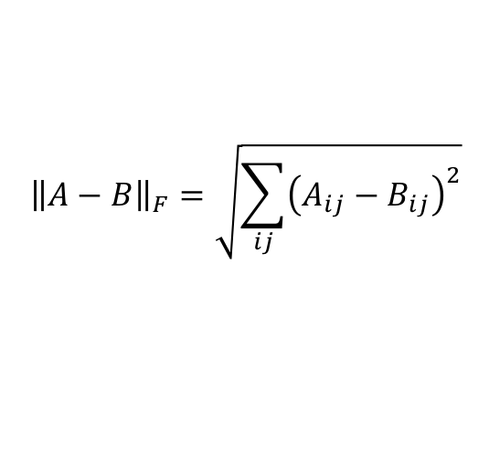
SVD – Best Low Rank Approx.
Fact: SVD gives ‘best’ axis to project on:
‘best’ = minimizing the sum of reconstruction errors
U
$${\left\|A−B\right\|}_{F}=\sqrt{\sum_{ij}{{\left(A_{ij}−B_{ij}\right)}^{2}}}$$
A
Sigma
=
V^{T}
B is best approximation of A:
B
U
Sigma
=
V^{T}

Slide 32
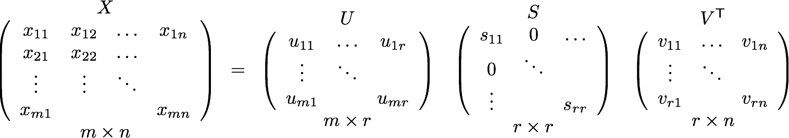
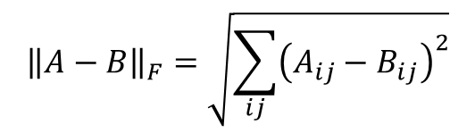



SVD – Best Low Rank Approx.
Theorem: Let A = U Σ V^{T} and B = U S V^{T} where S = diagonal rxr matrix with s_{i}=σ_{i} (i=1…k) else s_{i}=0 then B is a best rank(B)=k approx. to A
What do we mean by “best”:
B is a solution to min_{B} ǁA-Bǁ_{F} where rank(B)=k
$$Σ$$
$$σ_{11}$$
$$σ_{rr}$$
$${\left\|A−B\right\|}_{F}=\sqrt{\sum_{ij}{{\left(A_{ij}−B_{ij}\right)}^{2}}}$$
Refer to the MMDS book for a proof.
Notes:
Drop summations
USV – UXV = U-U(SV-XV)
AXC –AYC = (AC)(X-Y)

Slide 33
SVD - Conclusions so far
SVD: A= U Σ V^{T}: unique
U: user-to-concept factors
V: movie-to-concept factors
Σ : strength of each concept
Q: So what’s a good value for r?
Let the energy of a set of singular values be the sum of their squares.
Pick r so the retained singular values have at least 90% of the total energy.
Back to our example:
With singular values 12.4, 9.5, and 1.3, total energy = 245.7
If we drop 1.3, whose square is only 1.7, we are left with energy 244, or over 99% of the total

Slide 34
How to Compute SVD

Slide 35
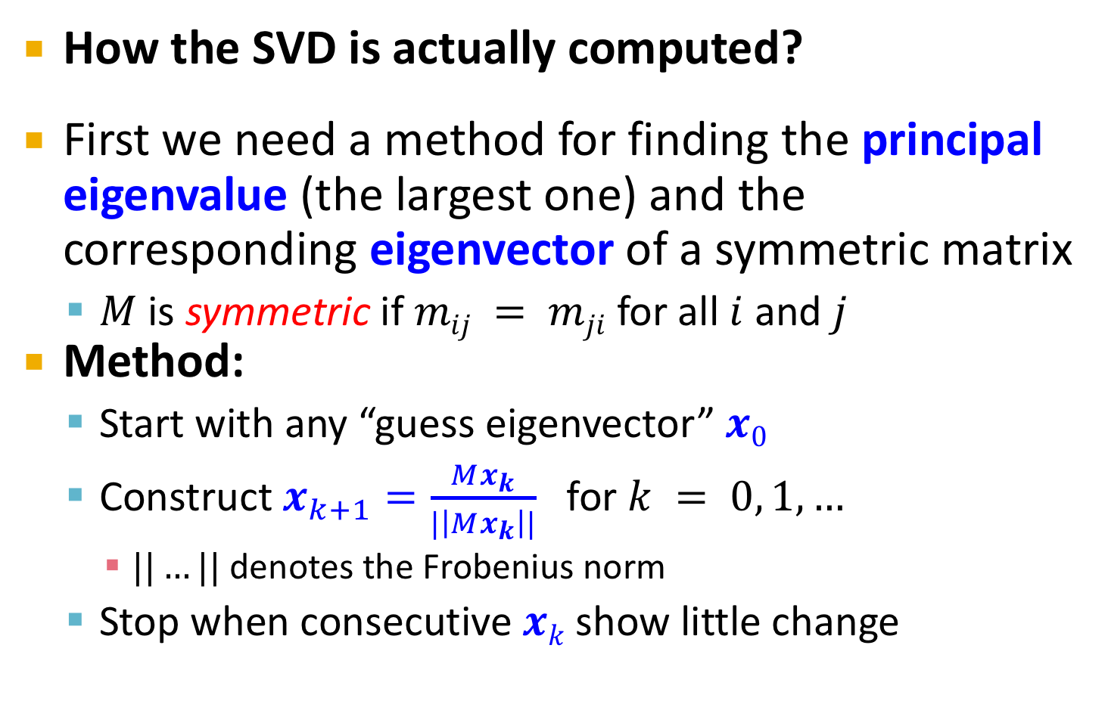
Finding Eigenpairs
How the SVD is actually computed?
First we need a method for finding the principal eigenvalue (the largest one) and the corresponding eigenvector of a symmetric matrix
$M$ is symmetric if $mij = mji$ for all $i$ and $j$
Method:
Start with any “guess eigenvector” $x0$
Construct $x_{k+1}=\frac{Mx_{k}}{|\left|Mx_{k}\right||}$ for $k = 0, 1,…$
$||…||$ denotes the Frobenius norm
Stop when consecutive $xk$ show little change

Slide 36
Example: Iterative Eigenvector
2
2 3
1
1
M =
x₀ =
Mx₀
3
5
0.51
0.86
=
/√34
=
=
x₁
||Mx₀||
Mx₁
2.23
3.60
0.53
0.85
=
/√17.93
=
=
x₂
||Mx₁||
…..

Slide 37
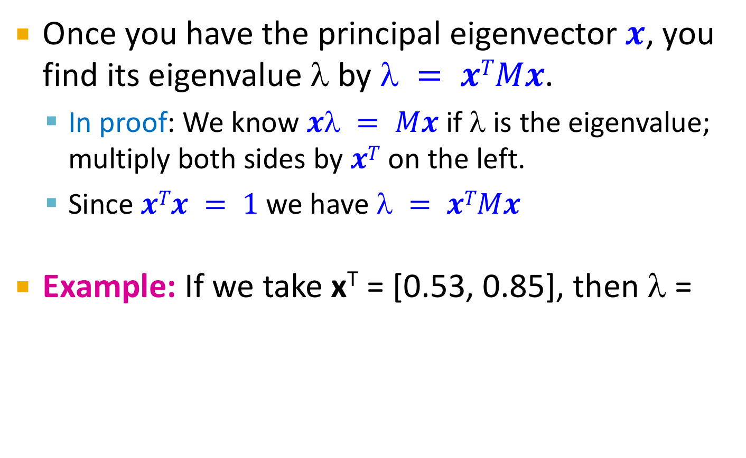
Finding the Principal Eigenvalue
Once you have the principal eigenvector $x$, you find its eigenvalue $$ by $ = xTMx$.
In proof: We know $x = Mx$ if $$ is the eigenvalue; multiply both sides by $xT$ on the left.
Since $xTx = 1$we have $ = xTMx$
Example: If we take x^{T} = [0.53, 0.85], then λ =
[
2
2 3
]
[
]
0.53
0.85
[0.53 0.85]
= 4.25

Slide 38
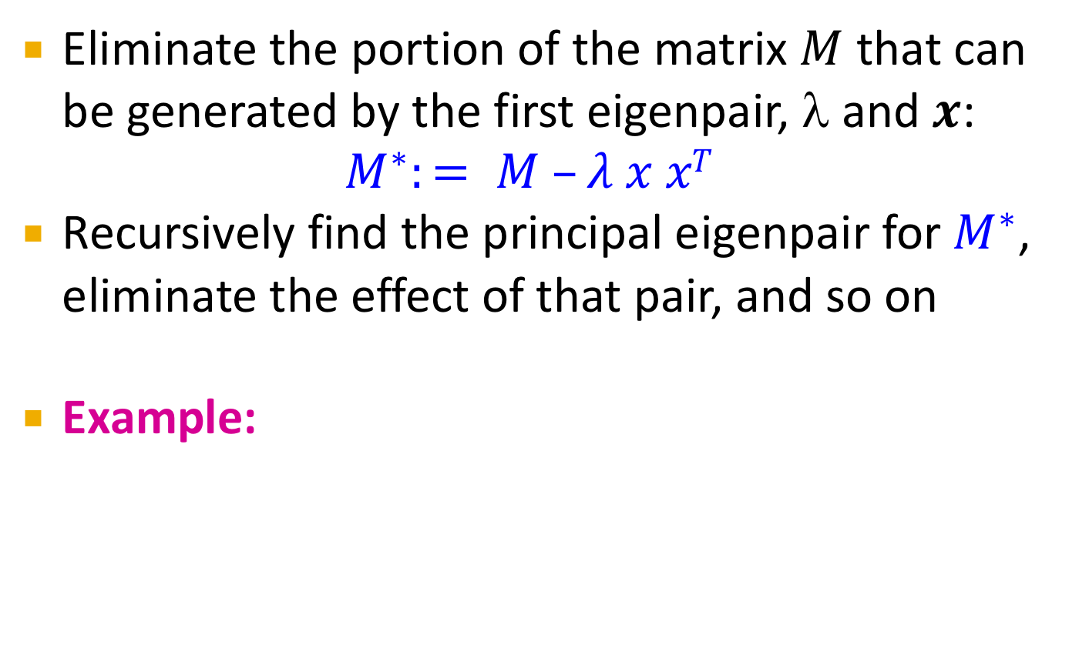
Finding More Eigenpairs
Eliminate the portion of the matrix $M$ that can be generated by the first eigenpair, λ and $x$:
$$M^{∗}:= M –λ x xT$$
Recursively find the principal eigenpair for $M^{∗}$, eliminate the effect of that pair, and so on
Example:
[
2
2 3
]
[
0.53
0.85
]
[
-0.19 0.09
0.09 0.07
]
M* =
– 4.25
[0.53 0.85]
=

Slide 39
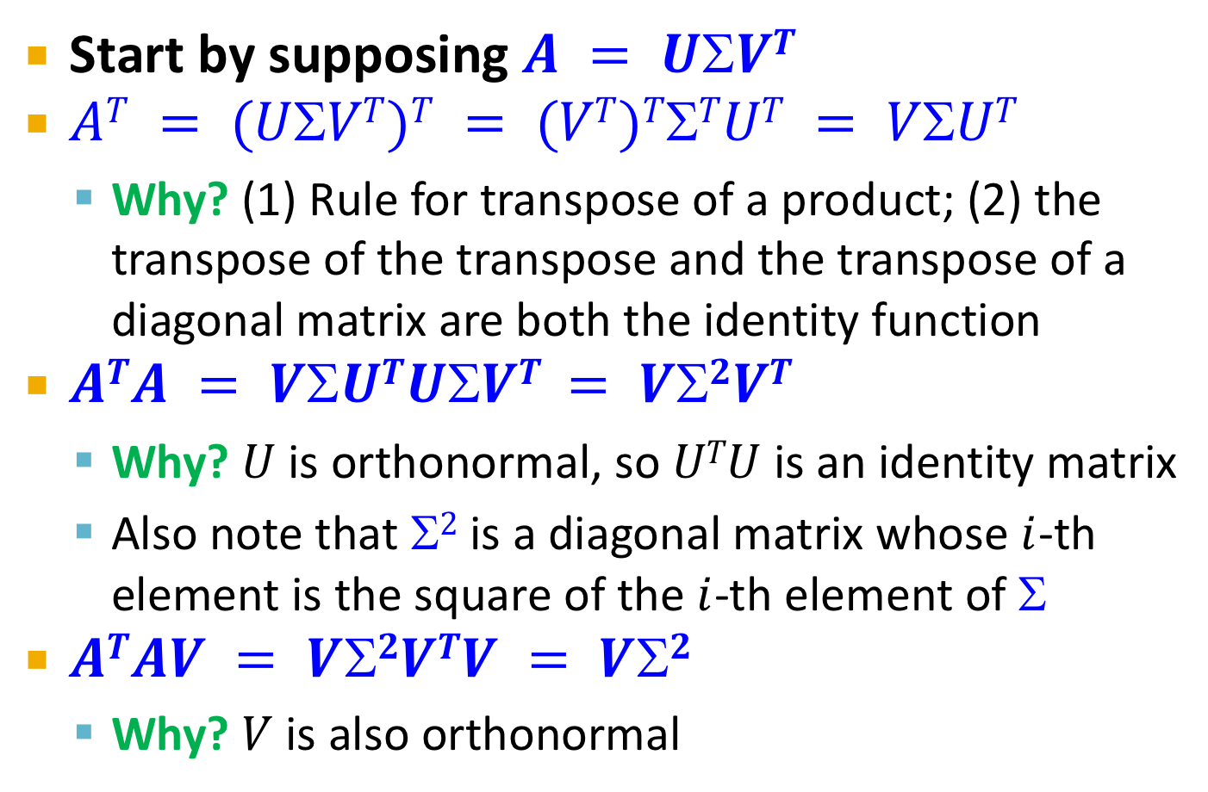
How to Compute the SVD
Start by supposing $A = UVT$
$AT = (UVT)T = (VT)TTUT = VUT$
Why? (1) Rule for transpose of a product; (2) the transpose of the transpose and the transpose of a diagonal matrix are both the identity function
$ATA = VUTUVT = V2VT$
Why? $U$ is orthonormal, so $UTU$ is an identity matrix
Also note that $2$ is a diagonal matrix whose $i$-th element is the square of the $i$-th element of $$
$ATAV = V2VTV = V2$
Why? $V$ is also orthonormal

Slide 40
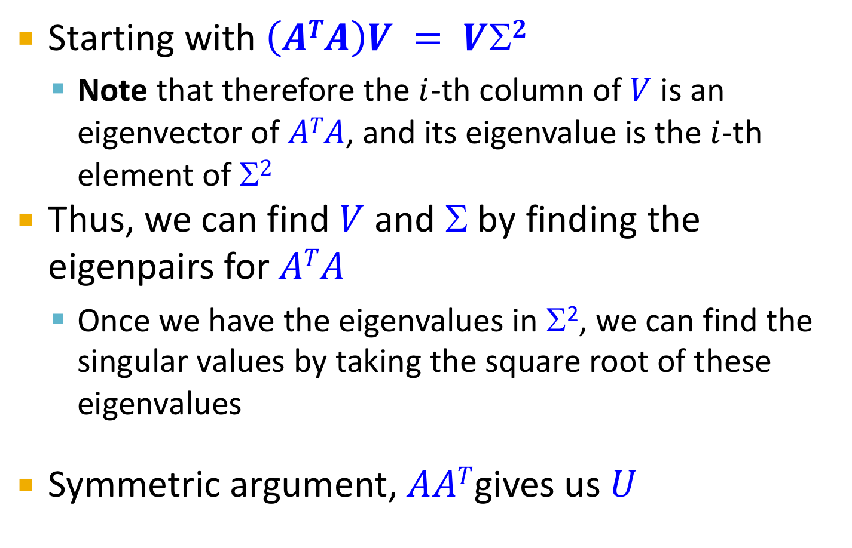
Computing the SVD –(2)
Starting with $\left(ATA\right)V = VΣ2$
Note that therefore the $i$-th column of $V$ is an eigenvector of $ATA$, and its eigenvalue is the $i$-th element of $2$
Thus, we can find $V$ and Σ by finding the eigenpairs for $ATA$
Once we have the eigenvalues in Σ², we can find the singular values by taking the square root of these eigenvalues
Symmetric argument, $AAT$gives us $U$

Slide 41
SVD - Complexity
To compute the full SVD using specialized methods:
O(nm²) or O(n²m) (whichever is less)
But:
Less work, if we just want singular values
or if we want first k singular vectors
or if the matrix is sparse
Implemented in linear algebra packages like
LINPACK, Matlab, SPlus, Mathematica ...

Slide 42
Example of SVD

Slide 43
Case study: How to query?
Q: Find users that like ‘Matrix’
A: Map query into a ‘concept space’ – how?
Matrix
Alien
Serenity
Casablanca
Amelie
1 1 1 0 0
3 3 3 0 0
4 4 4 0 0
5 5 5 0 0
0 2 0 4 4
0 0 0 5 5
0 1 0 2 2
0.13 0.02 -0.01
0.41 0.07 -0.03
0.55 0.09 -0.04
0.68 0.11 -0.05
0.15 -0.59 0.65
0.07 -0.73 -0.67
0.07 -0.29 0.32
SciFi
12.4 0 0
0 9.5 0
0 0 1.3
=
x
x
Romnce
0.56 0.59 0.56 0.09 0.09
0.12 -0.02 0.12 -0.69 -0.69
0.40 -0.80 0.40 0.09 0.09

Slide 44
Case study: How to query?
Q: Find users that like ‘Matrix’
A: Map query into a ‘concept space’ – how?
Matrix
Alien
Serenity
Casablanca
Amelie
Alien
q
q =
v2
v1
Project into concept space: Inner product with each ‘concept’ vector v_{i}
Matrix

Slide 45
Case study: How to query?
Q: Find users that like ‘Matrix’
A: Map query into a ‘concept space’ – how?
Matrix
Alien
Serenity
Casablanca
Amelie
Alien
q
q =
v2
v1
q*v₁
Project into concept space: Inner product with each ‘concept’ vector v_{i}
Matrix

Slide 46
Case study: How to query?
Compactly, we have:
q_{concept} = q V
E.g.:
Matrix
Alien
Serenity
Casablanca
Amelie
SciFi-concept
0.56 0.12
0.59 -0.02
0.56 0.12
0.09 -0.69
0.09 -0.69
x
=
2.8 0.6
q =
movie-to-concept
factors (V)

Slide 47
Case study: How to query?
How would the user d that rated (‘Alien’, ‘Serenity’) be handled? d_{concept} = d V
E.g.:
Matrix
Alien
Serenity
Casablanca
Amelie
SciFi-concept
0.56 0.12
0.59 -0.02
0.56 0.12
0.09 -0.69
0.09 -0.69
x
=
5.2 0.4
q =
movie-to-concept
factors (V)

Slide 48
Case study: How to query?
Observation: User d that rated (‘Alien’, ‘Serenity’) will be similar to user q that rated (‘Matrix’), although d and q have zero ratings in common!
Matrix
Alien
Serenity
Casablanca
Amelie
SciFi-concept
d =
5.2 0.4
q =
2.8 0.6
Zero ratings in common
Similarity > 0
Notes:
True since ratings are correlated and SVD uncovered this correlation

Slide 49
SVD: Drawbacks
Optimal low-rank approximation in terms of Frobenius norm
Interpretability problem:
A singular vector specifies a linear combination of all input columns or rows
Lack of sparsity:
Singular vectors are dense!
V^{T}
Σ
=
U

Slide 50
CUR Decomposition

Slide 51
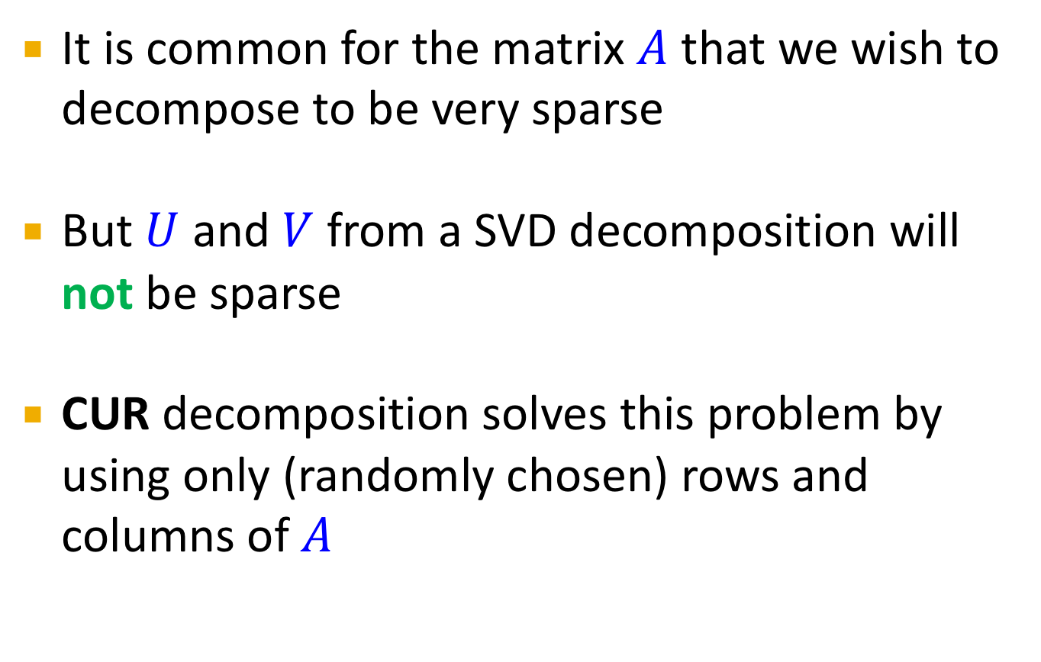
Sparsity
It is common for the matrix $A$ that we wish to decompose to be very sparse
But $U$ and $V$ from a SVD decomposition will not be sparse
CUR decomposition solves this problem by using only (randomly chosen) rows and columns of $A$

Slide 52
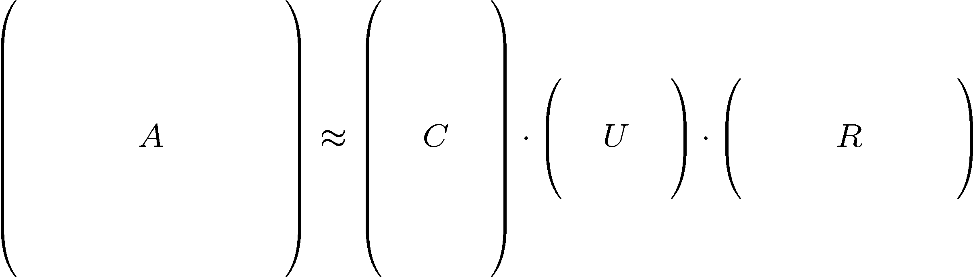
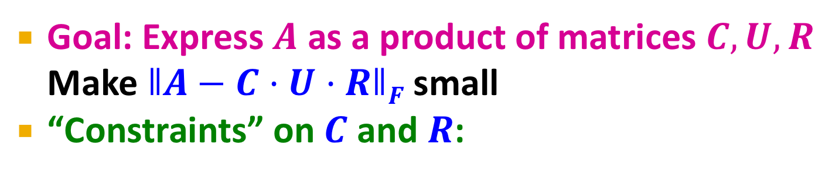
CUR Decomposition
Frobenius norm:
ǁXǁ_{F} = √ Σ_{ij} X_{ij}²
Goal: Express $A$ as a product of matrices $C,U,R$
Make $ǁA−C·U·RǁF$ small
“Constraints” on $C$ and $R$:
A
C
U
R

Slide 53
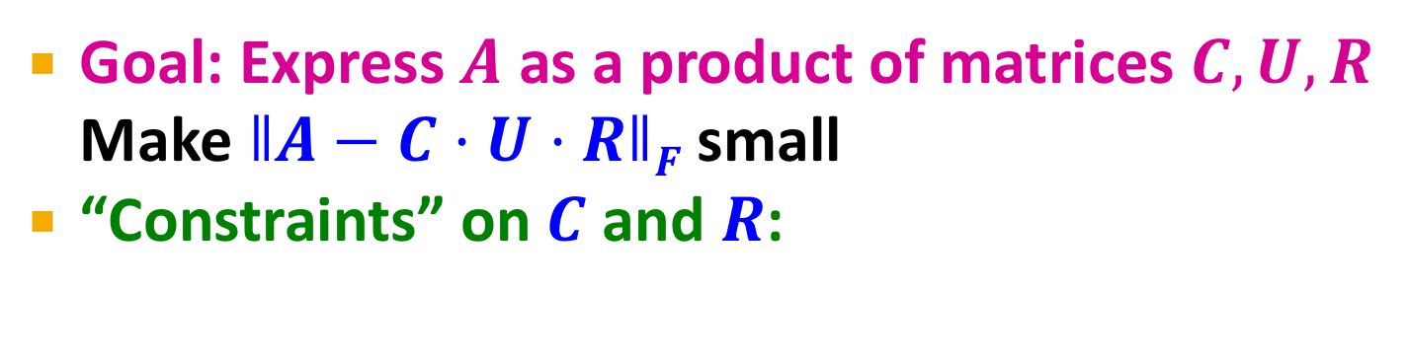
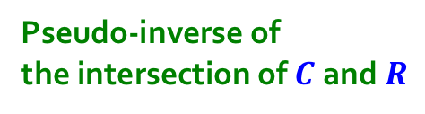
CUR Decomposition
Frobenius norm:
ǁXǁ_{F} = √ Σ_{ij} X_{ij}²
Goal: Express $A$ as a product of matrices $C,U,R$
Make $ǁA−C·U·RǁF$ small
“Constraints” on $C$ and $R$:
Pseudo-inverse of
the intersection of $C$ and$R$
A
C
U
R

Slide 54
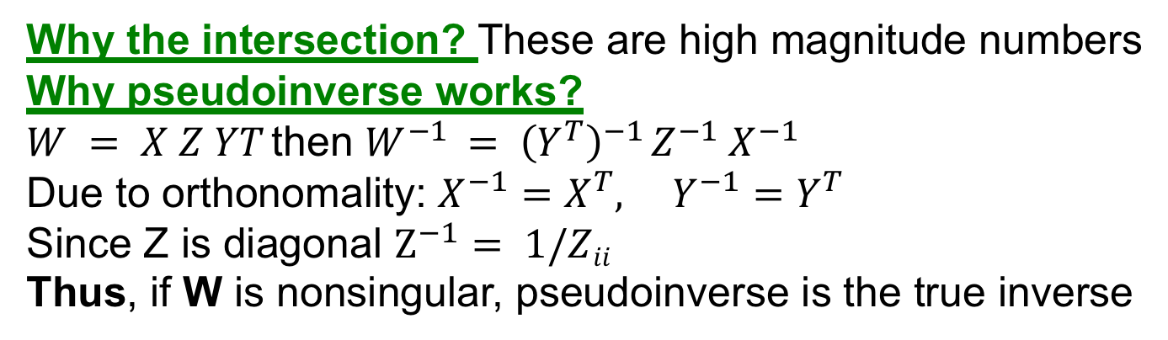
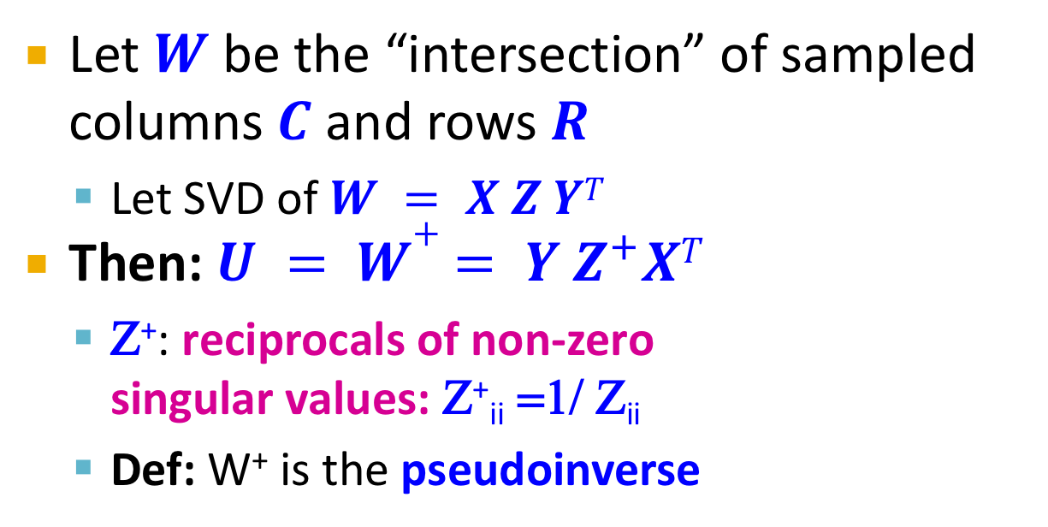
Computing U
Let $W$ be the “intersection” of sampled columns $C$ and rows $R$
Let SVD of $W = X Z YT$
Then: $U = W+ = Y Z^{+}XT$
Ζ⁺: reciprocals of non-zero singular values: Ζ⁺_{ii} =1/ Ζ_{ii}
Def: W⁺ is the pseudoinverse
columns, C
A
=
W
rows, R
intersection
Why the intersection? These are high magnitude numbers
Why pseudoinverse works?
$W = X Z YT$then $W^{−1} = {\left(Y^{T}\right)}^{−1} {Z^{−1} X}^{−1}$
Due to orthonomality: $X^{−1}=X^{T}, Y^{−1}=Y^{T}$
Since Z is diagonal $Z^{−1}= 1/Zii$
Thus, if W is nonsingular, pseudoinverse is the true inverse

Slide 55
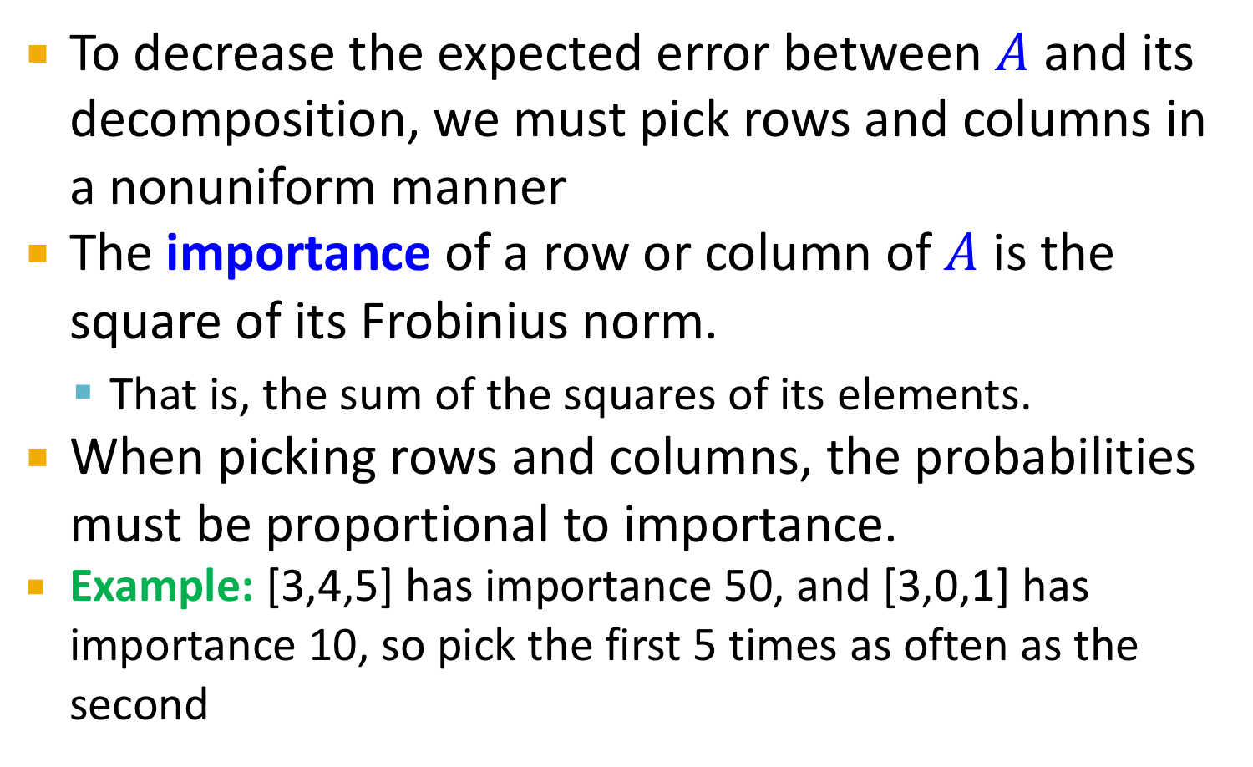
Which Rows and Columns?
To decrease the expected error between $A$ and its decomposition, we must pick rows and columns in a nonuniform manner
The importance of a row or column of $A$ is the square of its Frobinius norm.
That is, the sum of the squares of its elements.
When picking rows and columns, the probabilities must be proportional to importance.
Example: [3,4,5] has importance 50, and [3,0,1] has importance 10, so pick the first 5 times as often as the second

Slide 56
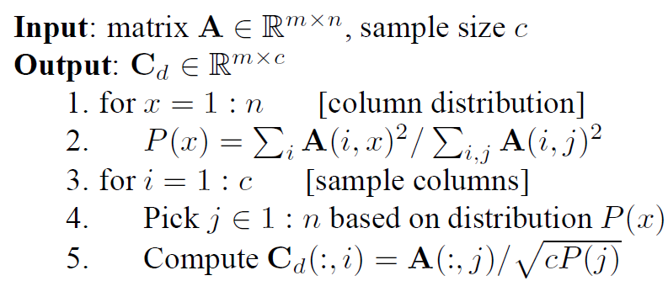
CUR: Row Sampling Algorithm
Sampling columns (similarly for rows):
Note this is a randomized algorithm, same column can be sampled more than once

Slide 57
Intuition
Actual column
Singular vector
Rough and imprecise intuition behind CUR
CUR is more likely to pick points away from the origin
Assuming smooth data with no outliers these are the directions of maximum variation
Example: Assume we have 2 clouds at an angle
SVD dimensions are orthogonal and thus will be in the middle of the two clouds
CUR will find the two clouds (but will be redundant)

Slide 58
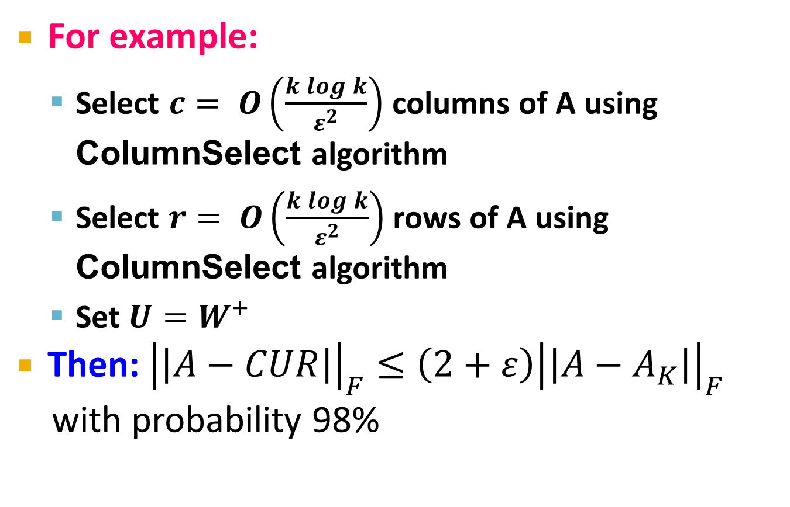
CUR: Provably good approx. to SVD
For example:
Select $c= O\left(\frac{k\log{k}}{ε^{2}}\right)$ columns of A using ColumnSelect algorithm
Select $r= O\left(\frac{k\log{k}}{ε^{2}}\right)$ rows of A using ColumnSelect algorithm
Set $U=W^{+}$
Then: ${\left|\left|A−CUR\right|\right|}_{F}≤\left(2+ε\right){\left|\left|A−A_{K}\right|\right|}_{F}$
with probability 98%
SVD error
CUR error
In practice:
Pick 4k cols/rows for a “rank-k” approximation
Notes:
HOW TO PICK NUMBER of COS/ROWS In practice. Mahoney’s slides say pick 4k cols/rows

Slide 59
CUR: Pros & Cons
Easy interpretation
Since the basis vectors are actual columns and rows
Sparse basis
Since the basis vectors are actual columns and rows
Duplicate columns and rows
Columns of large norms will be sampled many times
Actual column
Singular vector

Slide 60
SVD vs. CUR
sparse and small
SVD: A = U Σ V^{T}
Huge but sparse
Big and dense
dense but small
CUR: A = C U R
Huge but sparse
Big but sparse

Slide 61
SVD vs. CUR: Simple Experiment
DBLP bibliographic data
Author-to-conference big sparse matrix
A_{ij}: Number of papers published by author i at conference j
428K authors (rows), 3659 conferences (columns)
Very sparse
Want to reduce dimensionality
How much time does it take?
What is the reconstruction error?
How much space do we need?

Slide 62
Results: DBLP- big sparse matrix
SVD
SVD
CUR
CUR no duplicates
SVD
CUR
CUR no dup
CUR
Accuracy:
1 – relative sum squared errors
Space ratio:
#output matrix entries / #input matrix entries
CPU time
Sun, Faloutsos: Less is More: Compact Matrix Decomposition for Large Sparse Graphs, SDM ’07.
Notes:
http://www.cs.cmu.edu/~jimeng/papers/SunSDM07.pdf

